Slide 1
M.A.R.S
Aaron Jarmusch, Jacob Stafford,
Joel Huffman, Ethan Conway

Slide 2

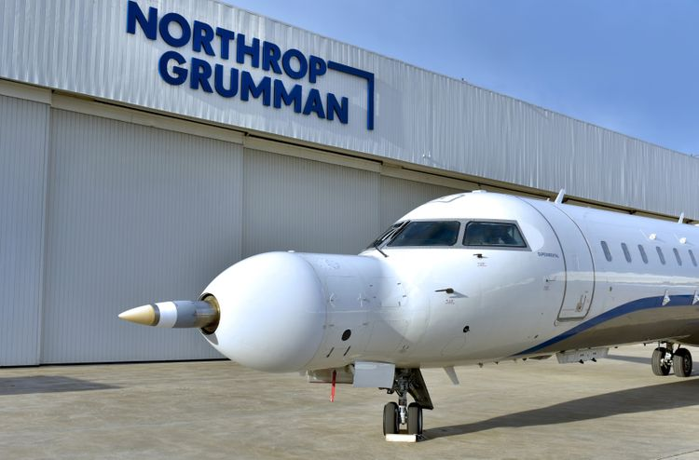
Northrop Grumman
Company we are working with throughout the year.
American multinational aerospace and defense technology company.
Working with Andrew Meyer, John Stolan, and other Northrop Grumman engineers.
Notes:
Project Outline - Aaron

Slide 3

The M.A.R.S Problem
Rocket Launch to Mars
Expected Launch in 28’
Electronic System
Moving Platform for Space Exploration
Noise Experienced
Electromagnetic Interference
Thermal Noise
Mechanical Noise
Notes:
Project Outline - Aaron
Motor Algorithmic Regulation System
Resolver Problem Statement: Resolvers are used by NGC to measure the angular position of brushless motors. These devices are analog in nature and measuring the position requires comparing the amplitudes of two sine waves in the secondary windings (S1 and S2 below). It is desired to find a method using configurable logic (firmware) that will reliably measure the rotor angular position and velocity being sensed by the resolver. The configurable logic may use D/A converters to excite the primary windings and A/D converters to sense the secondary winding response. Matlab Simulink shall be used to model the resolver, electronics and configurable logic so as to demonstrate the selected design
Electromagnetic Interference (EMI): EMI is a type of noise that can occur when electrical signals from the rocket's electronic systems interfere with each other. This can result in unwanted signals that can affect the quality of the signal.
Thermal Noise: Thermal noise is a type of noise that is caused by the random motion of electrons in a conductor. This noise can be amplified by the high temperatures generated during rocket launch, which can cause unwanted signals and distortions in the electrical signals.
Mechanical Noise: Mechanical noise can be caused by the vibrations and shocks generated during the rocket launch. These vibrations can cause unwanted noise and distortion in the electrical signals.

Slide 4

The Current Solution
Northrop Grumman
Current Implementation
Self-Developed Microcontroller Board
Reduces Weight
Test Multiple Algorithms
Current Algorithm
Similar to a Phase Locked Loop
Notes:
Aaron

Slide 5
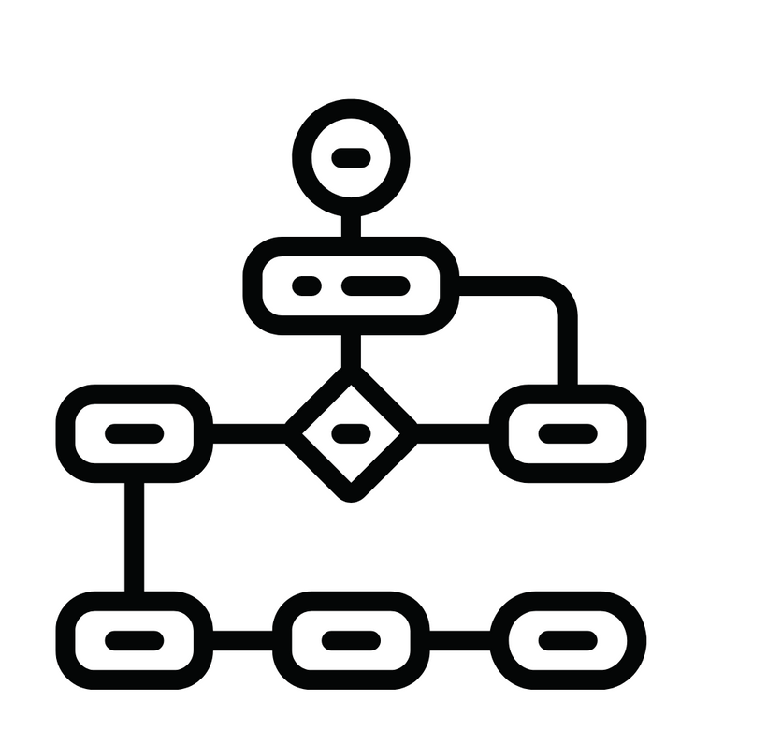
Our Solutions
Matlab Simulink
Physical Build of Resolver and Resolver Encoder
Phase Locked Loop (PLL)
Third-Order Rational Polynomial (3-ORP)
S-Transform (S-T)
Recurrent Neural Network (RNN)
Notes:
Aaron

Slide 6
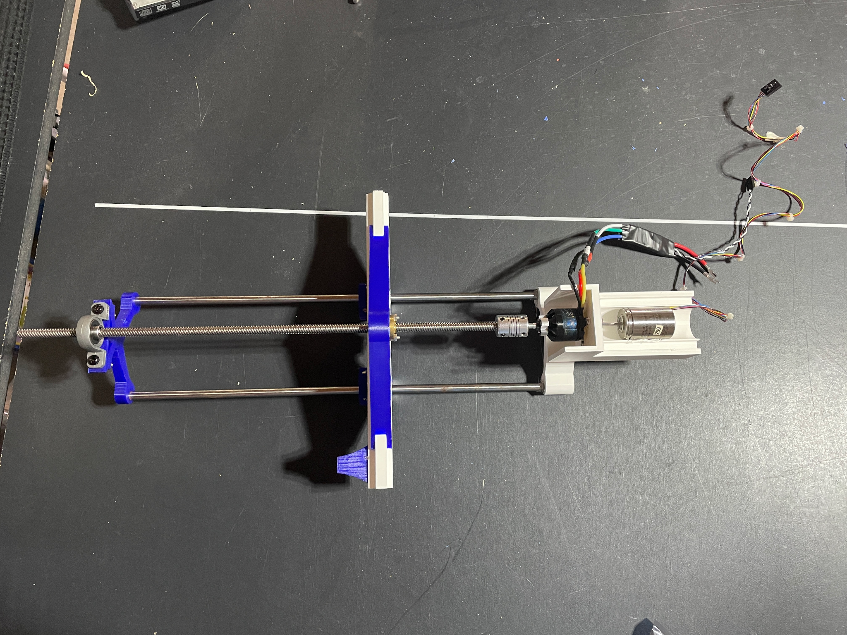
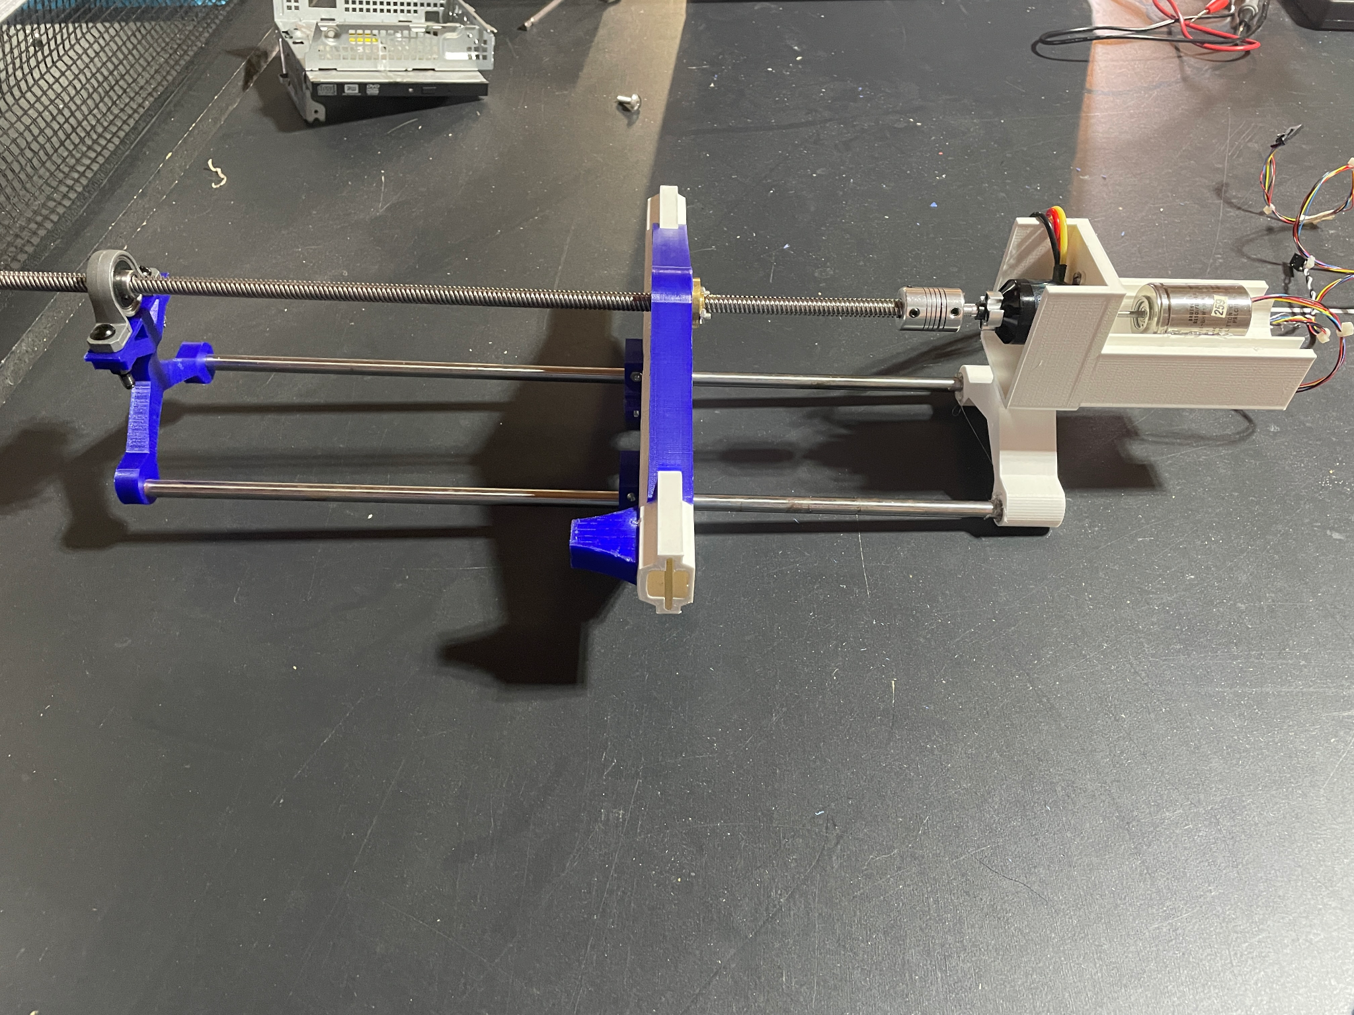
Physical Apparatus
The apparatus consists of:
Brushless motor
Resolver
ESC
Two couplers
Threaded rod
3D printed stand
Top View of Apparatus
Side View of Apparatus
Notes:
joel

Slide 7
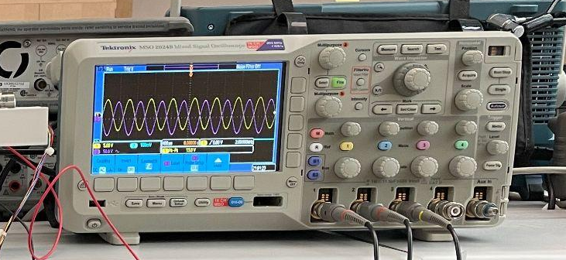
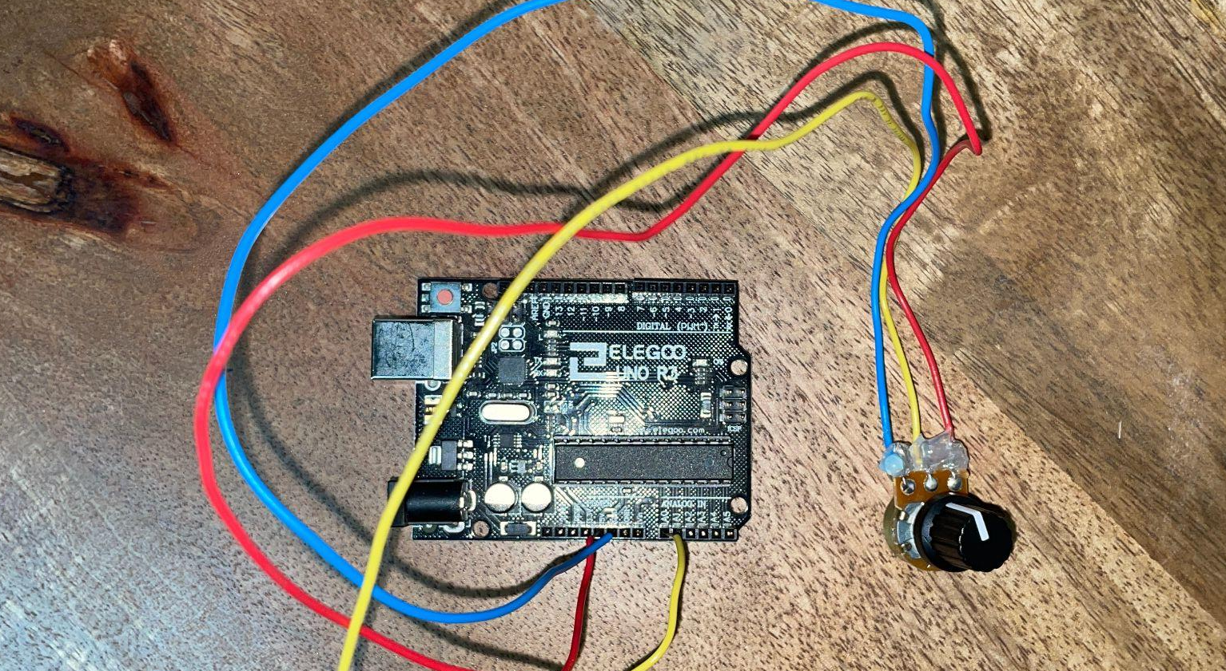
Physical Apparatus (cont)
Also included:
Arduino
10k Potentiometer
Power Supply
Oscilloscope
Waveform generator
Oscilloscope to measure resolver. Sine (Yellow), Cosine (Purple).
We can use the data from the oscilloscope and feed it into our various algorithms.
Arduino to send PWM signal and potentiometer to control motor.
Notes:
joel

Slide 8
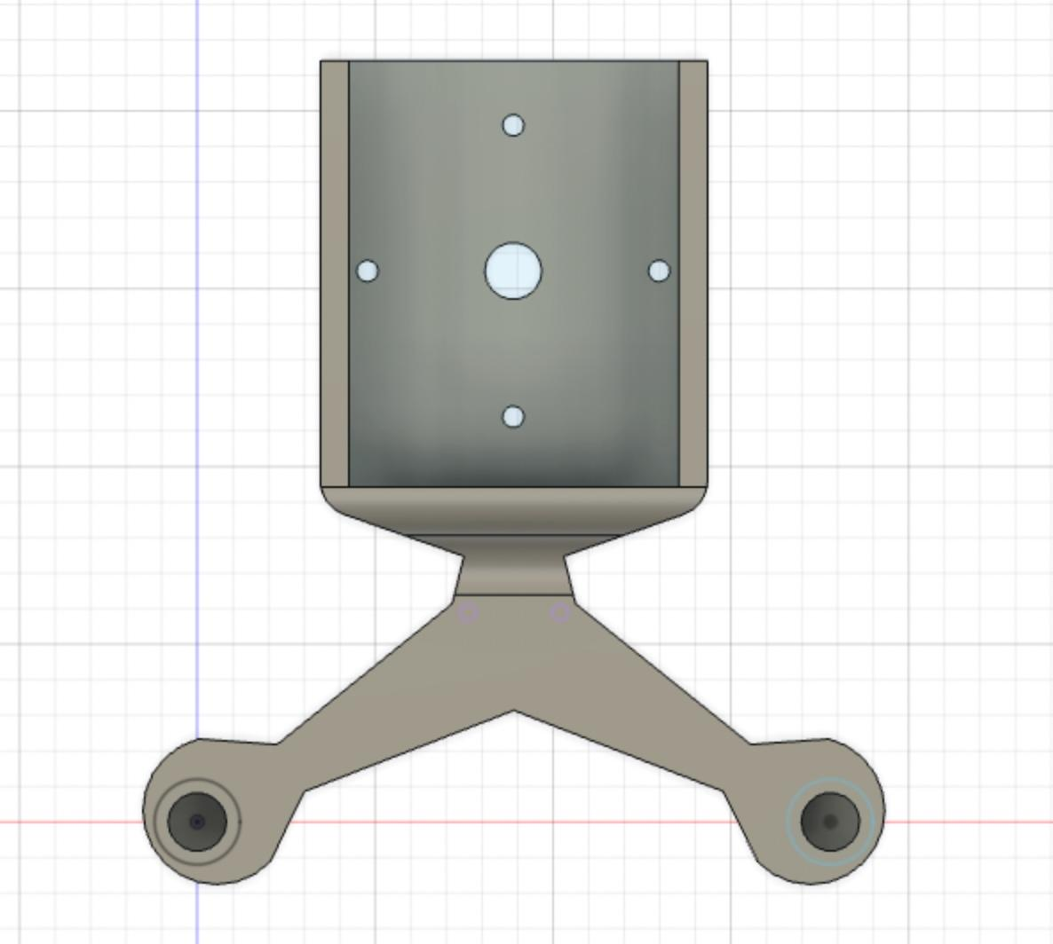
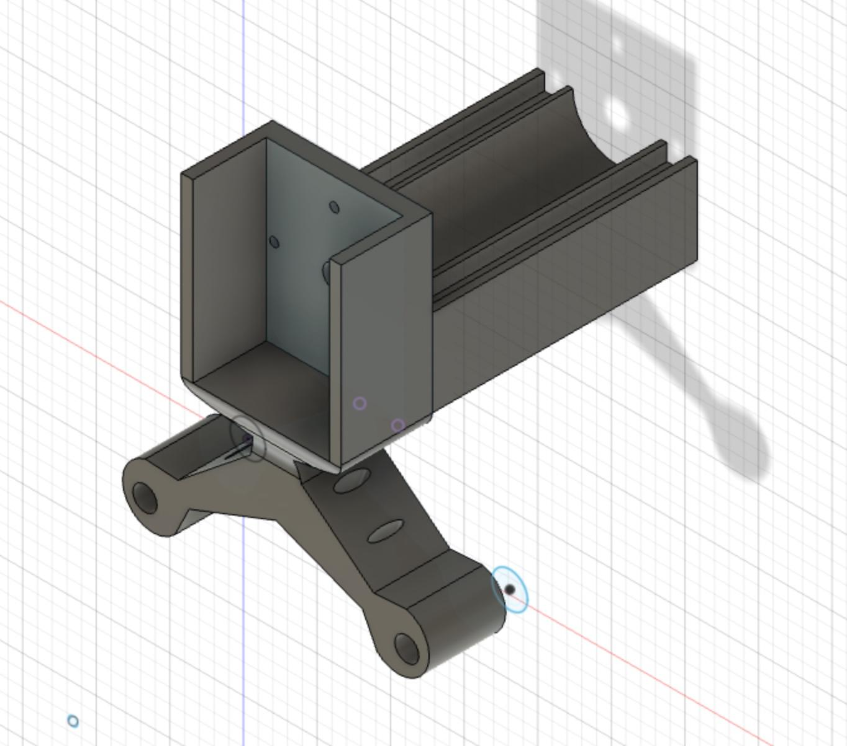
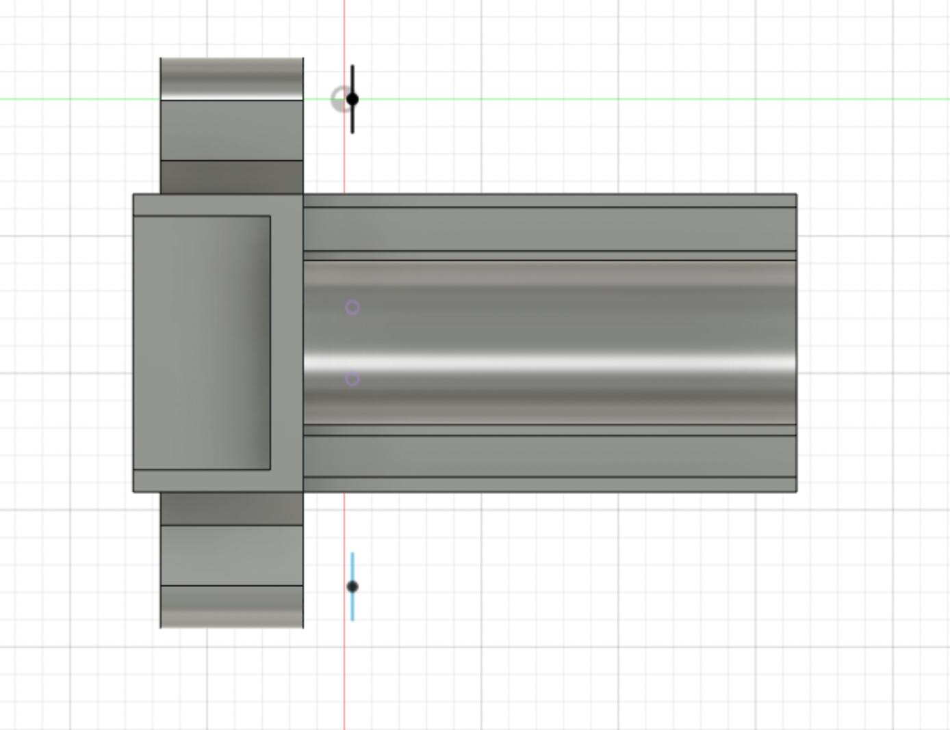
3D Printed Apparatus Piece
Notes:
joel

Slide 9
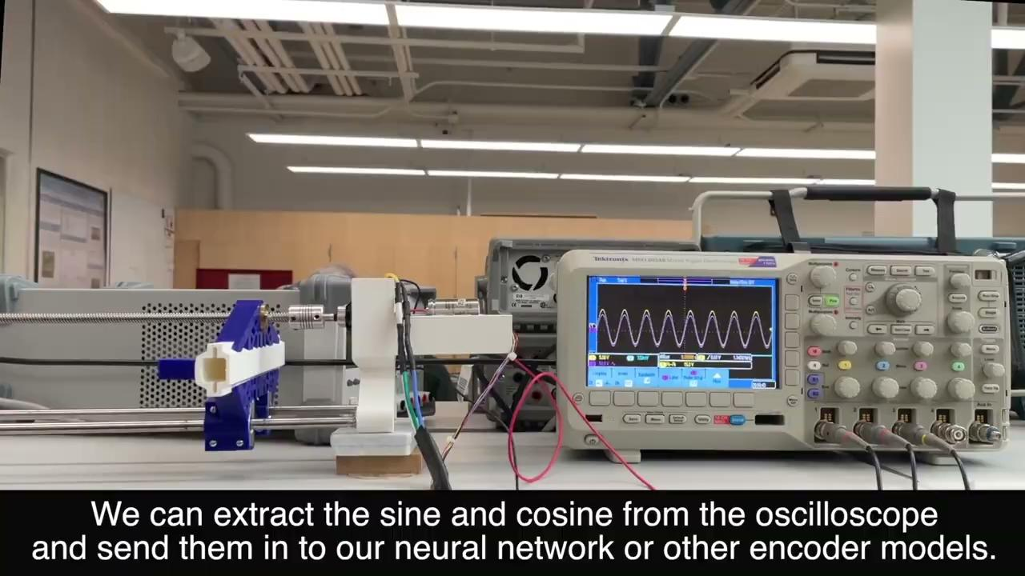
Apparatus Demo
Notes:
joel

Slide 10
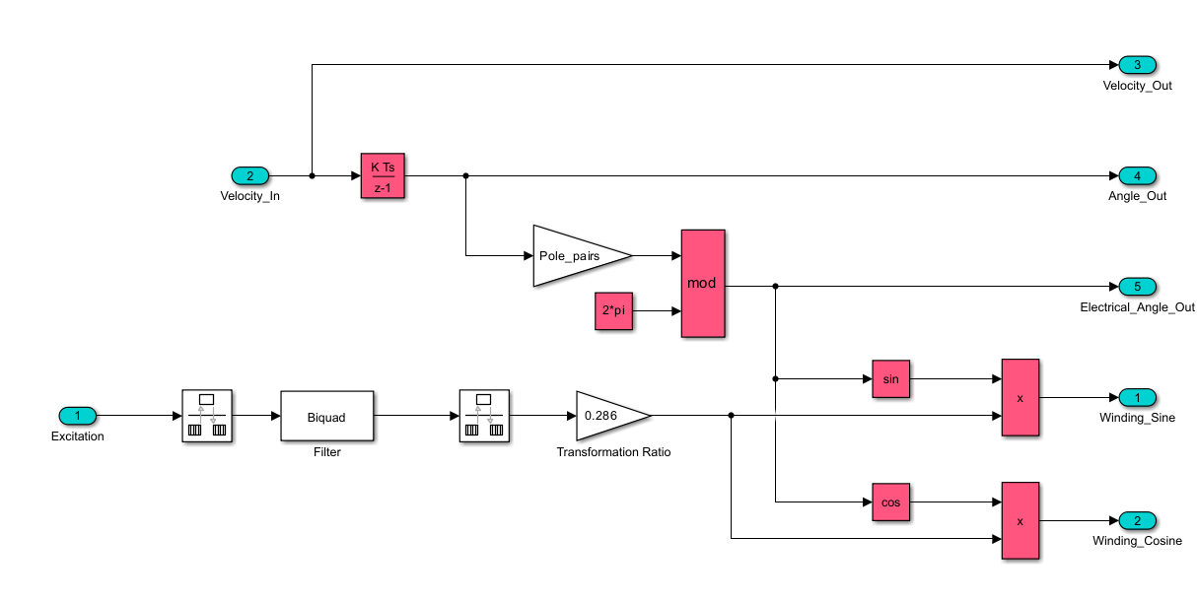
Resolver with Simulink
Notes:
JS

Slide 11
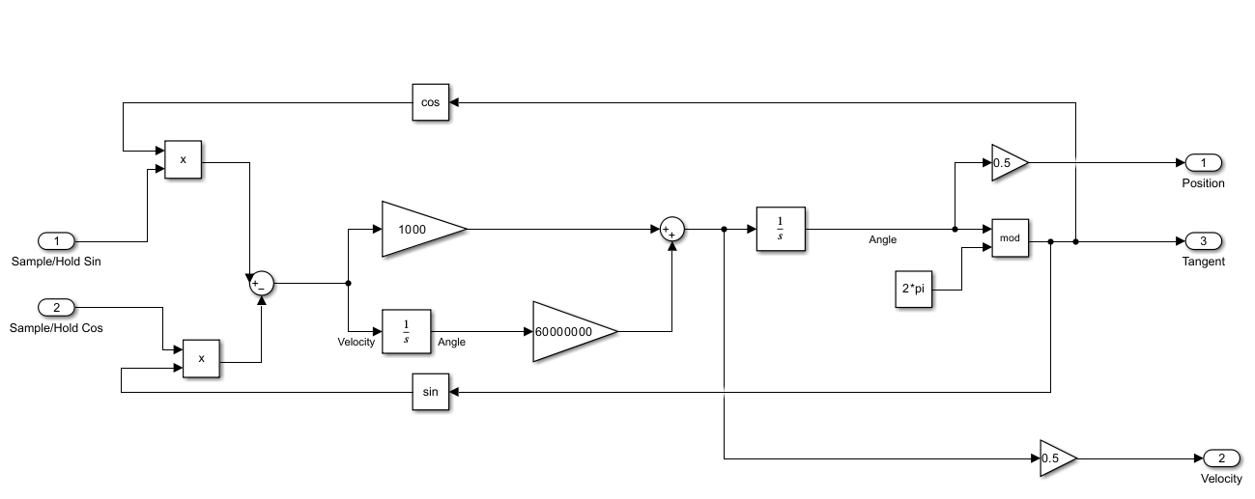
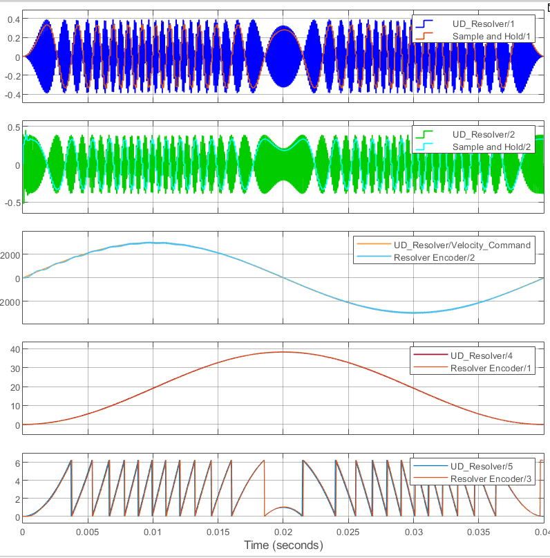
PLL Resolver Encoder with Simulink
Notes:
JS

Slide 12
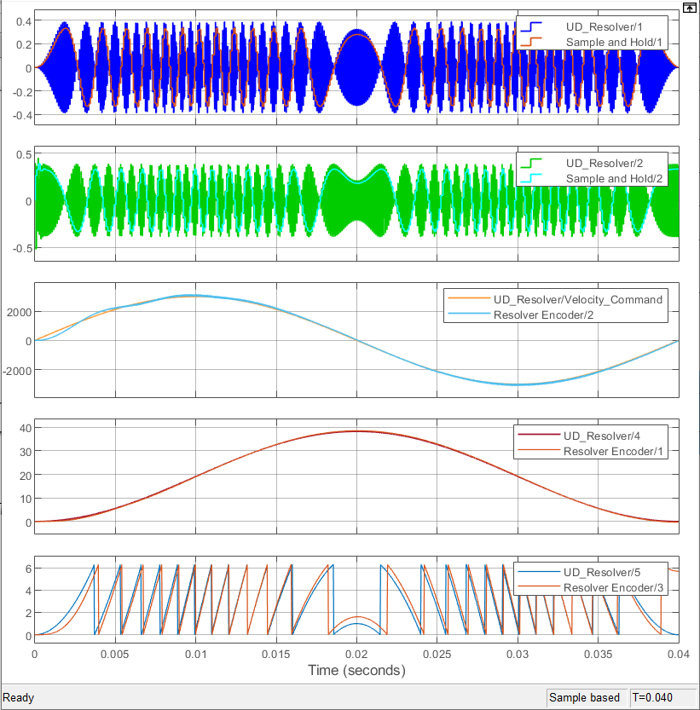
PLL Resolver Encoder with Simulink
Notes:
JS

Slide 13
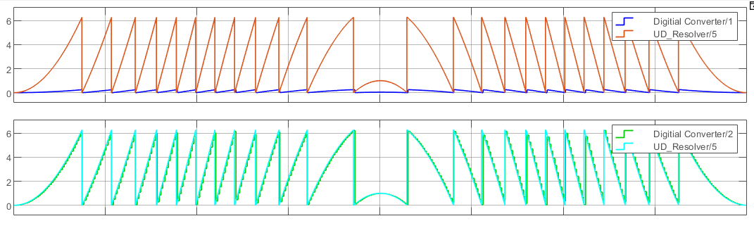
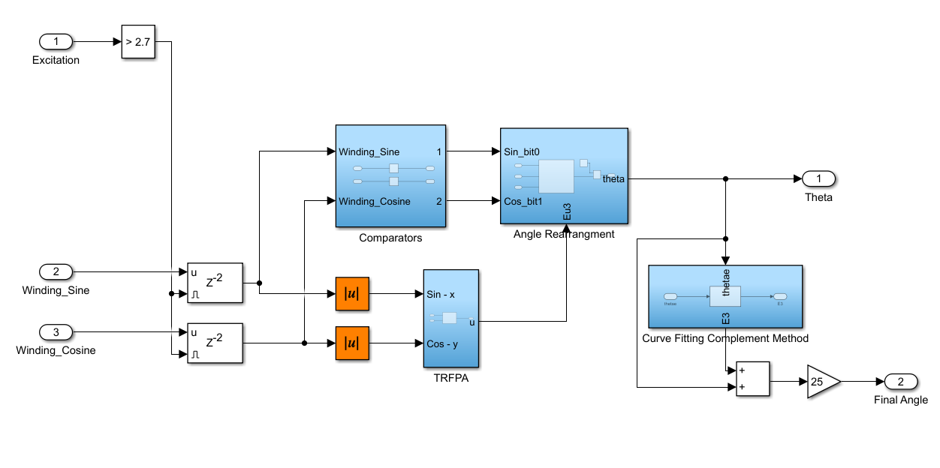
Third-Order Ration Polynomial
Notes:
JS

Slide 14
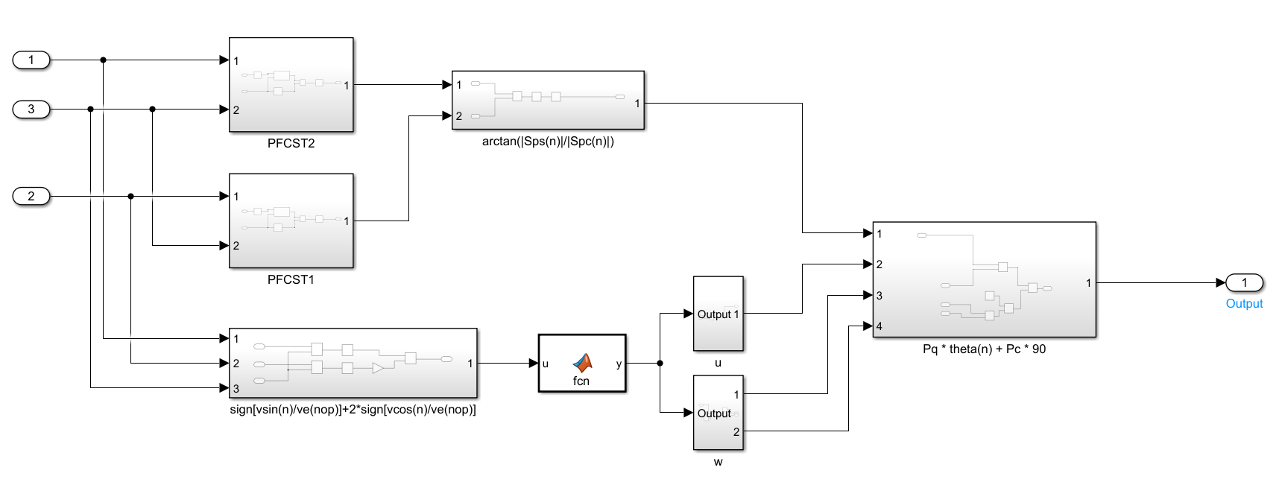
S-Transform Resolver Encoder with Simulink
Notes:
JS

Slide 15
How did these help with our project?
Apparatus:
Gives us a physical model to help us generally understand what the real world application is for this project, and how the work that we’re doing in simulink factors into the real application.
Simulink:
Main thing NG partnered with us to create. Gives us a virtual model that allows us to test and change values without having to adjust anything physically.
Notes:
Ethan

Slide 16
Working with a third party
Process of getting started on the entire project was slow
NDA wasn’t signed until the end of the first semester, didn’t know what was expected of us, didn’t know the scope of the project
Once regular meeting times were established, ended up getting a lot of work done with the help of NG
Utilized research papers given by NG to work on resolver encoder simulations
Continued work on physical apparatus
Explored neural networks
Notes:
Ethan

Slide 17
Where would we go from here?
Expand the amount of Simulink models
3 models were built and tested for the project, testing more could potentially lead to a better output.
Continue work on the neural network
Neural network was tested, but not one of our goals to complete given by NG. Has the potential to work better than a simulink model, but would need more work and training.
Notes:
Ethan

Slide 18
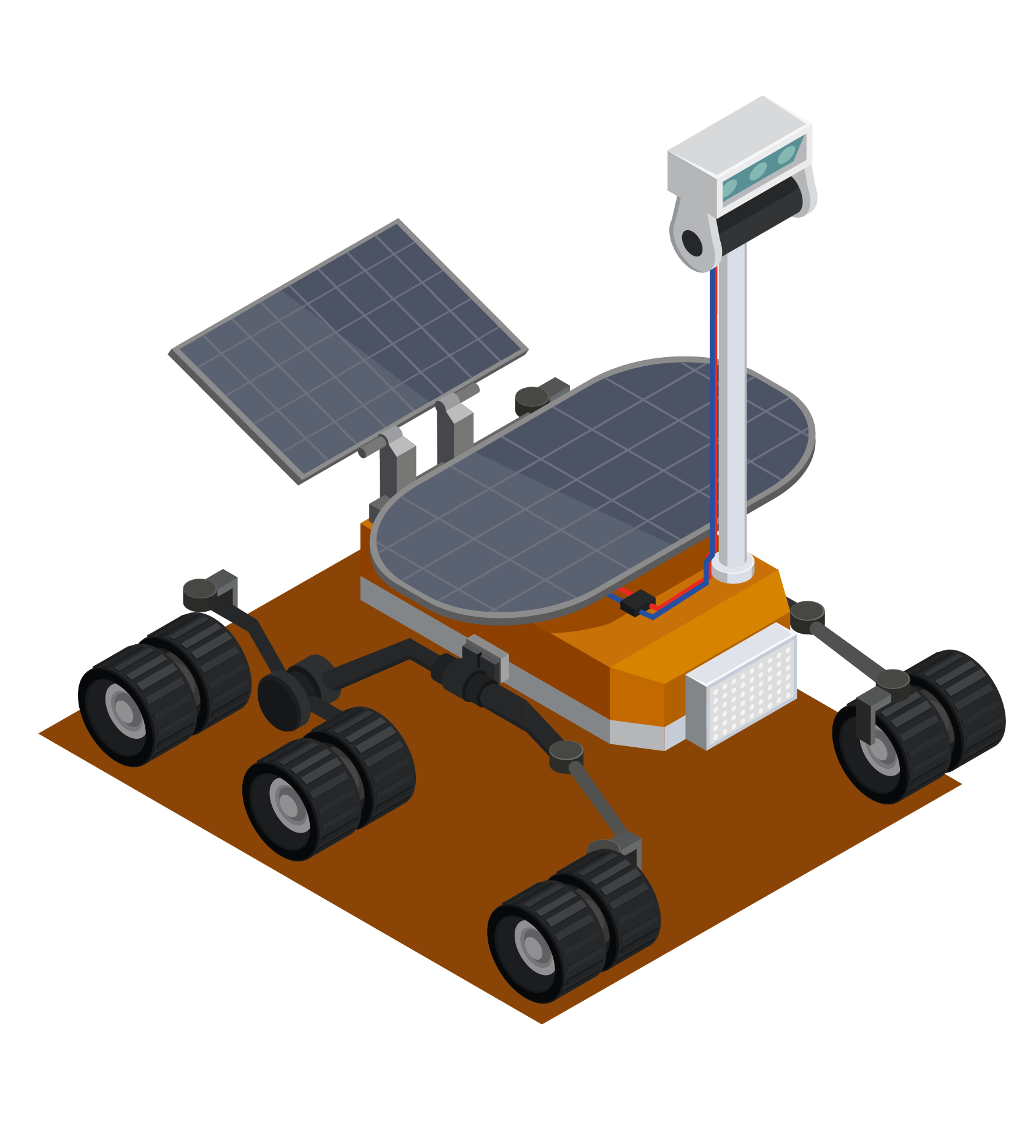




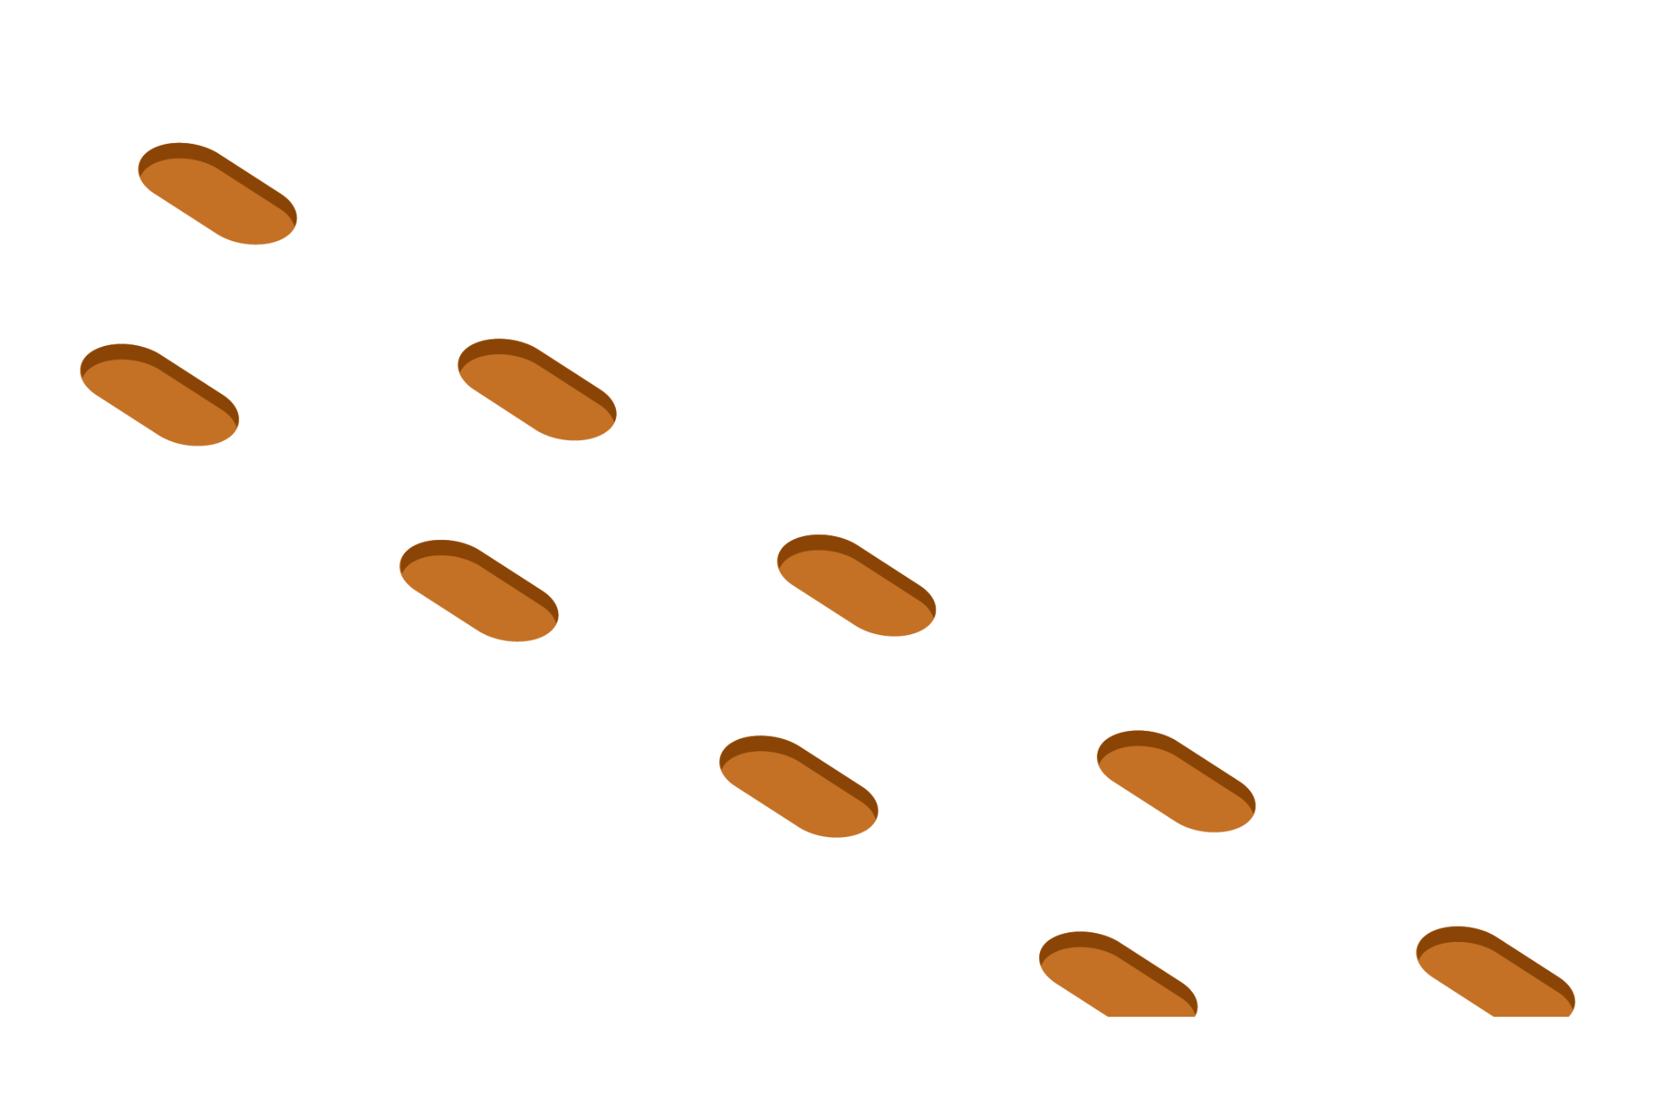

Questions?

